Slide 1
Chapter 5
Linear Regression with multiple variables
Multiple features

Slide 2
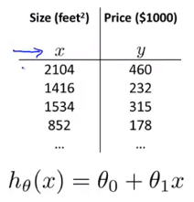
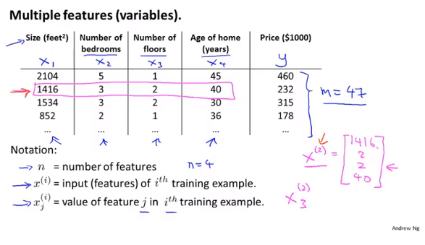
Chapter 5

Slide 3
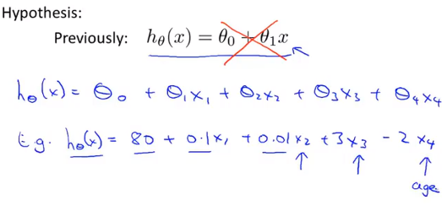
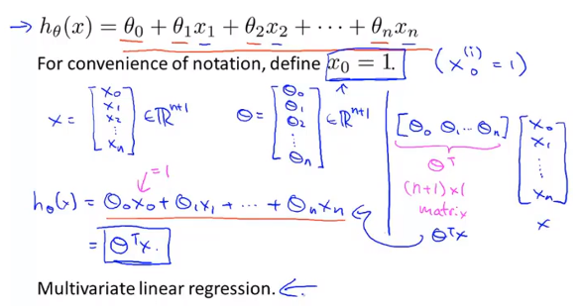
Chapter 5

Slide 4
Chapter 5
Linear Regression with multiple variables
Gradient descent for multiple variable

Slide 5
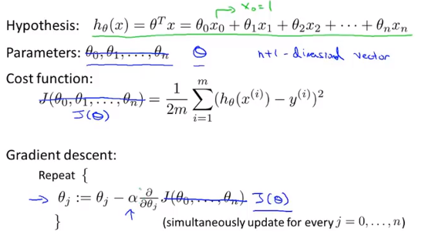
Chapter 5

Slide 6
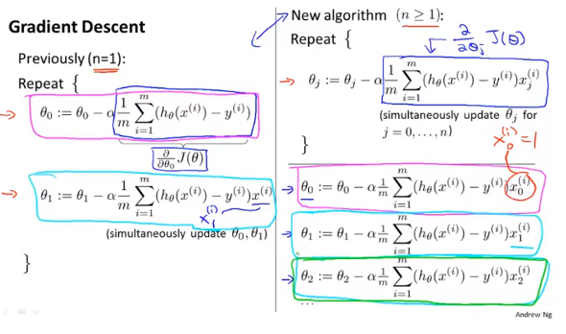
Chapter 5

Slide 7
Chapter 5
Linear Regression with multiple variables
Gradient descent in practice Ⅰ: Feature Scaling
Feature scaling: divide some number so that every x satisfy -1 <= x <= 1
Mean Normalization: minus mean to normalize
You can use both simultaneously

Slide 8
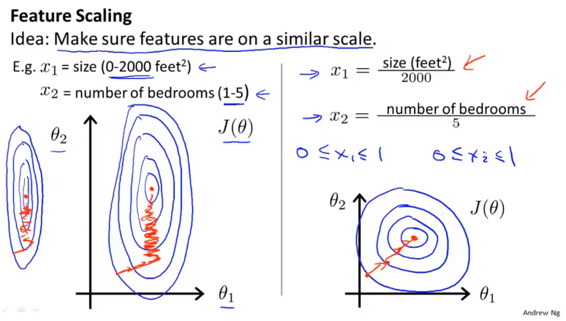
Chapter 5

Slide 9
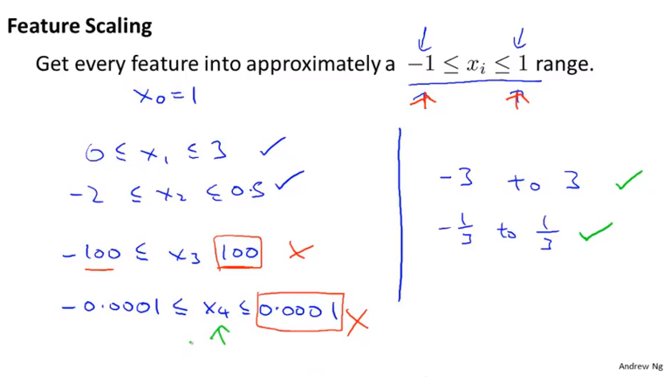
Chapter 5

Slide 10
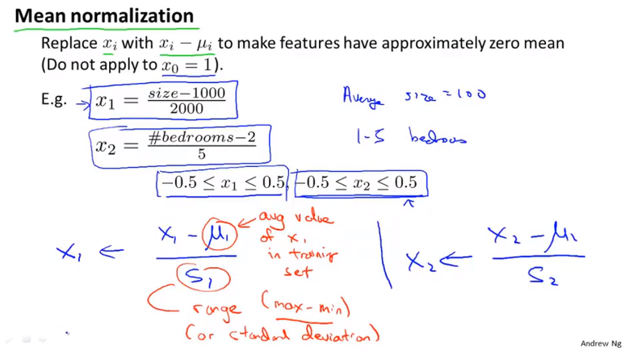
Chapter 5

Slide 11
Chapter 5
Linear Regression with multiple variables
Gradient descent in practice Ⅱ: Learning rate

Slide 12
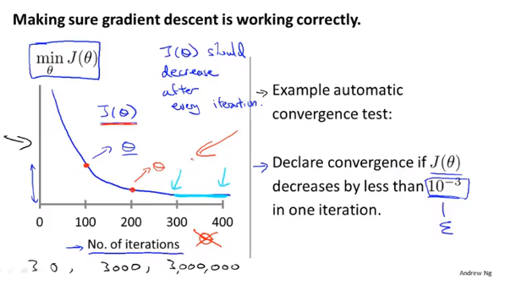
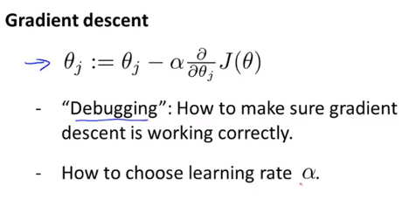
Chapter 5

Slide 13
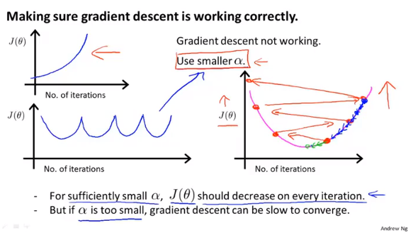
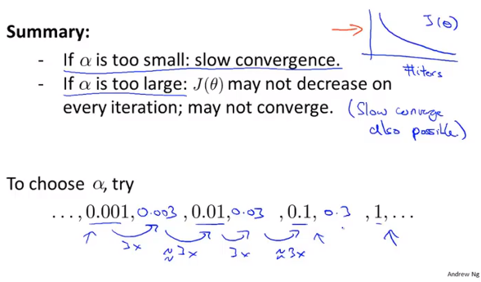
Chapter 5

Slide 14
Chapter 5
Linear Regression with multiple variables
Features and polynomial regression

Slide 15
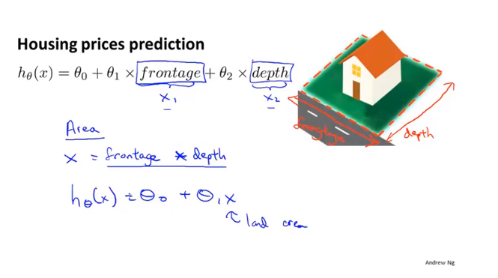
Chapter 5

Slide 16
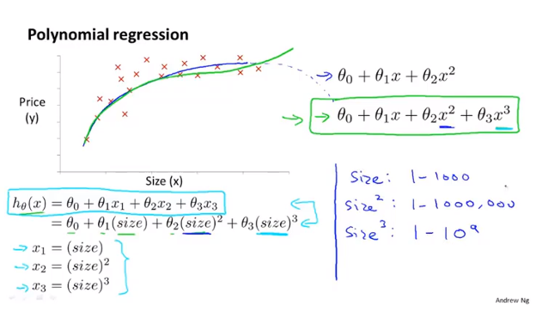
Chapter 5
Using the machinery of multivariant linear regression

Slide 17
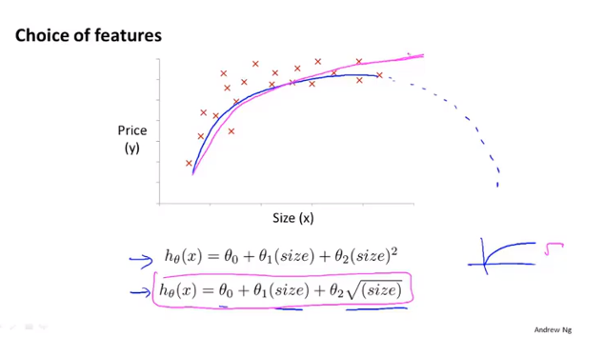
Chapter 5

Slide 18
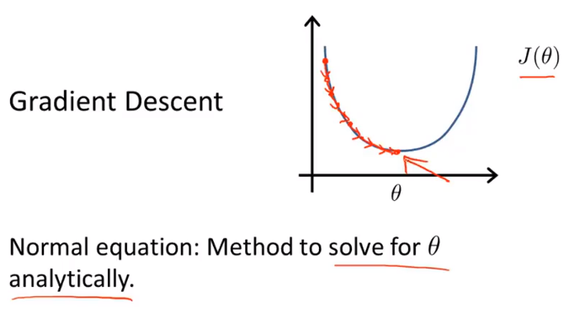
Chapter 5
Linear Regression with multiple variables
Normal equation
One step to solve for theta

Slide 19
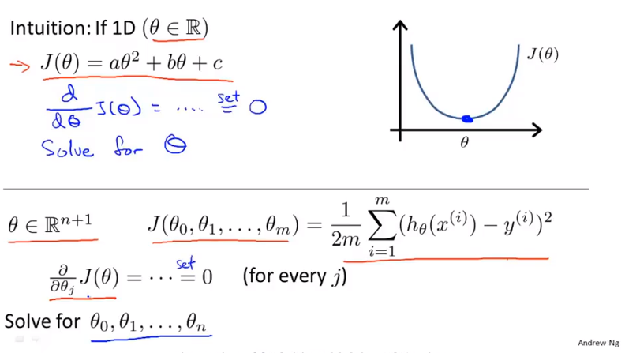
Chapter 5

Slide 20
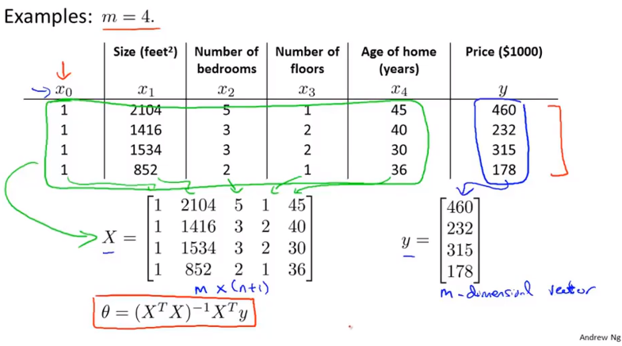
Chapter 5

Slide 21
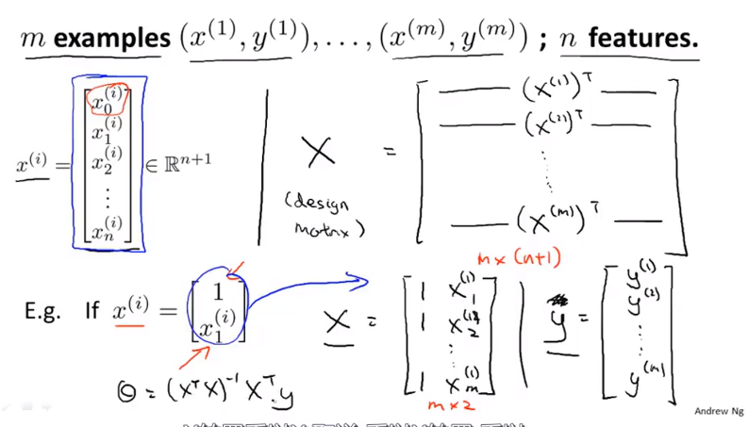
Chapter 5

Slide 22
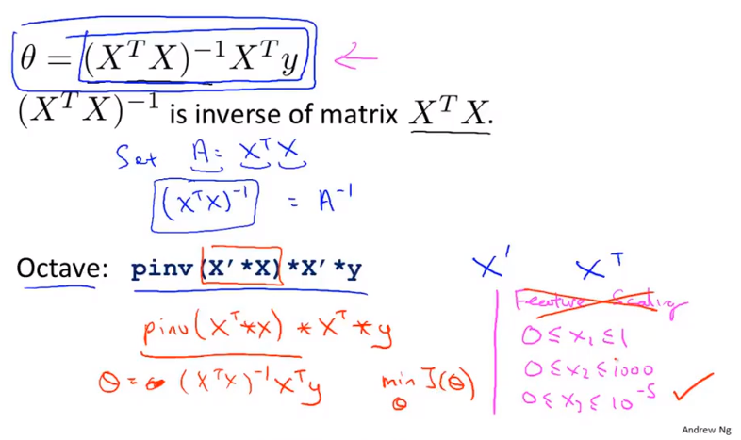
Chapter 5
Normal equation do not need feature scaling

Slide 23
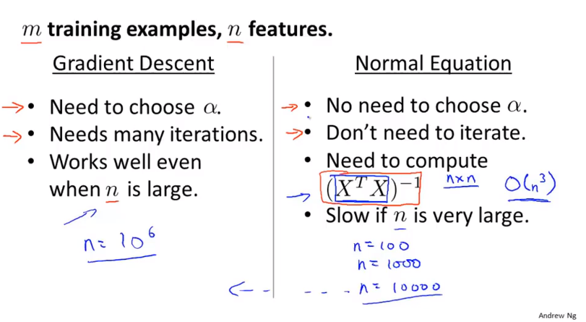
Chapter 5

Slide 24
Chapter 5
Linear Regression with multiple variables
Normal equation and non-invertibility (optional)

Slide 25
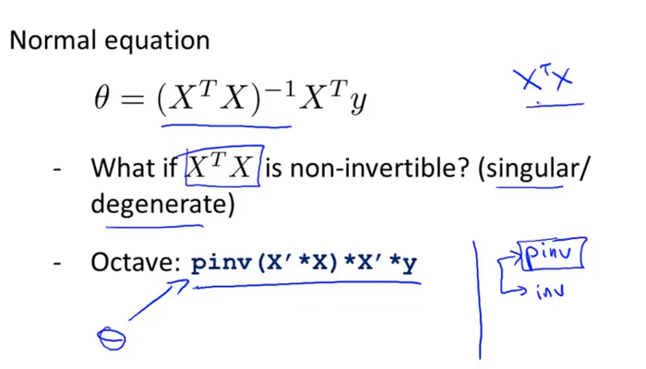
Chapter 5
pinv pseude-inverse
Inv inverse

Slide 26
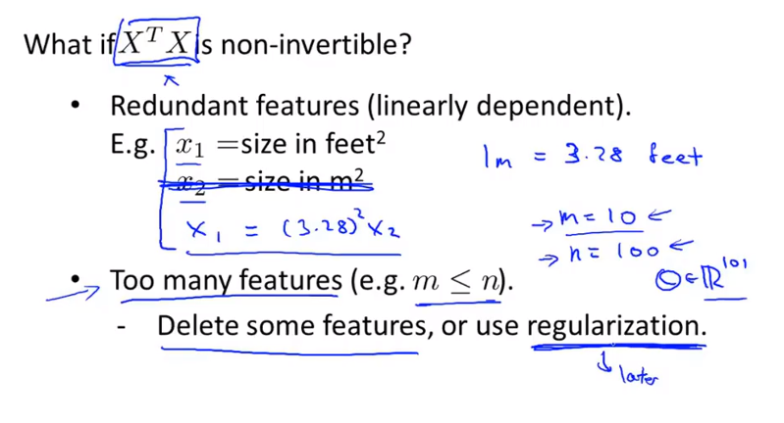
Chapter 5
Linearly dependent cause redundant feature

